Slide 1

Elementary Device Deployment
Parent/Student Orientation
Information for Families

Slide 2
Student Expectations

Slide 3
Student Expectations
Adhere to the KCS Dress Code. Remember that instruction is in a live environment.
Engage in a way that creates a safe and respectful environment for teachers and students.
Follow all KCS policies when utilizing technology. KCS reserves the right to monitor all technology resource activity.
Check Canvas or other teacher communication formats daily. Teachers will provide scheduled office hours - minimum of two hours per week.
Adhere to all assessment policies for diagnostic, benchmark, and Standards Based Assessments. Some assessments may require students to participate in person.
Engage in virtual discussions, submit assignments, and maintain the pace of the course.
Report any technical issues to your teacher as soon as an issue arises.
Refer to the KCS Parent/Student Handbook for additional information regarding student expectations.

Slide 4
Parent Expectations

Slide 5
Parent Expectations
Virtual learning is a partnership between parent, student and the virtual teacher.
Keep contact information current in Aspen.
Follow the daily schedule for the student which is provided by the teacher.
Maintain open lines of communication (phone and email) with the teacher.
Support your student as they engage in their learning- submitting assignments, follow academic integrity, participating in virtual meetings, attend mandatory testing, etc.
Communicate any issues or questions to the teacher.
No videos or photos should be taken and/or shared. Recording instruction or interaction is prohibited due to student privacy concerns.
Make sure there is someone supervising students participating in virtual learning.
Refer to the KCS Parent/Student Handbook for additional information regarding parent expectations.

Slide 6
Technology Systems

Slide 7




Technology Systems
Aspen is the system for grades, attendance, and communication. Aspen Family Portal allows for communication concerning student progress. | Canvas is the learning management system. Student content, tasks, and feedback will all be housed here. This is a student’s digital backpack. | Google Drive allows students to store various work products as documents, spreadsheets, or presentations. Connects with Canvas. | Microsoft Teams is the system used to video chat. Connects with Canvas.
Additional supports for each of the Technology Systems can be found on our KCS Connect site.

Slide 8

Technology Systems- How to Support
Ensure that email and phone information is current. Set notifications | Become a Parent Observer Set notifications | Check students brower history in Chrome Review student work and ask them what they are doing | Set-up a place for students to join their virtual meeting (plain wall, good lighting) Ensure no distractions or extra noise Support students to get connected.
Additional supports for each of the Technology Systems can be found on our KCS Connect site.

Slide 9
Device Use and Care

Slide 10
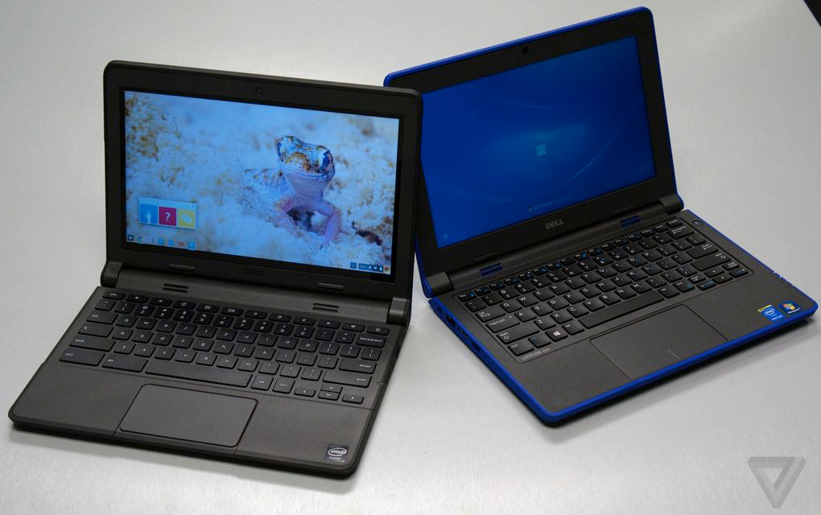
Chromebooks
Laptops that use Google's Chrome operating system
Navigate in the Chrome web browser
Work from web-based applications through Google Drive like Google Docs, Slides, and Sheets
Storage is in the cloud
Additional resources are available to navigate the Chromebook.

Slide 11
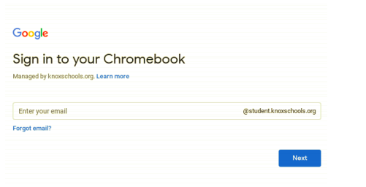
Student Log In
Sample Student Login
John Smith
Student ID #1234567
Username: S1234567@student.knoxschools.org
Password: JS4567kcs

Slide 12
Use of the Device
Devices should only be used for educational activities.
The technology device is property of the Knox County Schools and may be collected and inspected at any time. Students have no right to privacy for any material when using a district technology device.
If a student’s technology device is lost or stolen, the student should report the loss immediately to the teacher (if the device is stolen off campus, a police report should be completed immediately.).
Filtering software is installed to block social media and other sites and filters based on content keywords.

Slide 13
Care of the Device
The care of the district technology device is the student’s responsibility. Students should not lend their device to another person.
Technology devices should be kept at room temperature and should NOT be exposed to extremes of hot or cold. Students should NOT LEAVE their technology device IN THE CAR. Students should not leave their technology device outside.
Liquids and food should not be used/consumed in the vicinity of the technology device.
Cleaners, sprays, alcohol, ammonia or abrasives should not be on the technology device. Devices should be cleaned with a soft, lint-free cloth.
If a student’s technology device is not working or is damaged, students should report the problem immediately to the help desk.
If a student’s technology device is lost or stolen, the student should report the loss immediately to the administration (if the device is stolen off campus, a police report should be completed).

Slide 14
Best Practices
Use your device for KCS assignments and learning
Only use your user name and password
Do not share your user name and password with others
KCS technicians should be the only ones to repair your device
Treat your device with respect.

